Slide 1



Customize ISO Image For Media Industry User
- Jiamin Yuan & Jonathan Dimitriu

Slide 2
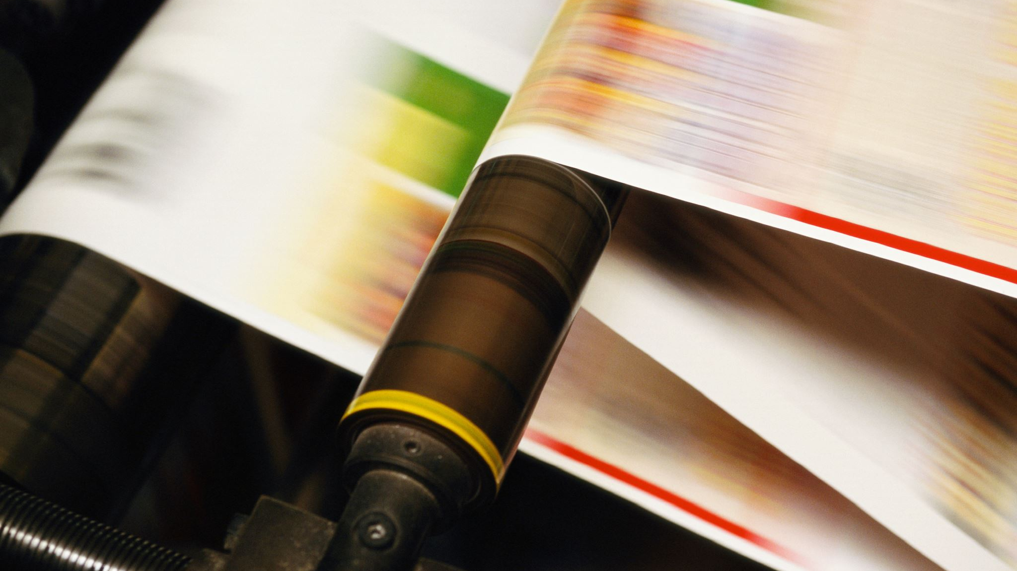
Project description
A working ubuntu iso image with specific packages for media professionals. This includes providing them with software combinations that are customized to them (such as Photoshop alternatives, video and audio editing, painting tools, etc).

Slide 3
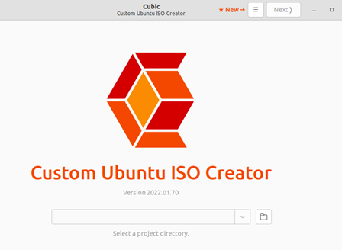
Major technical decision
We ended up choosing Ubuntu between Debian and Ubuntu.
Ubuntu comes with a software called Cubic can be used to customize the iso image.
It's a more beginner-friendly alternative.
Ubuntu also offers the advantage of having Ubuntu Studio, which integrates photo, video, and audio editing functions.

Slide 4
Git Repository
https://github.com/DeadBwain/Unix-Final-Project

Slide 5
Major struggles
Cubic takes a long time to test custom-built iso images. Each test takes roughly one to two hours.
Export the iso image from the virtual machine.

Slide 6
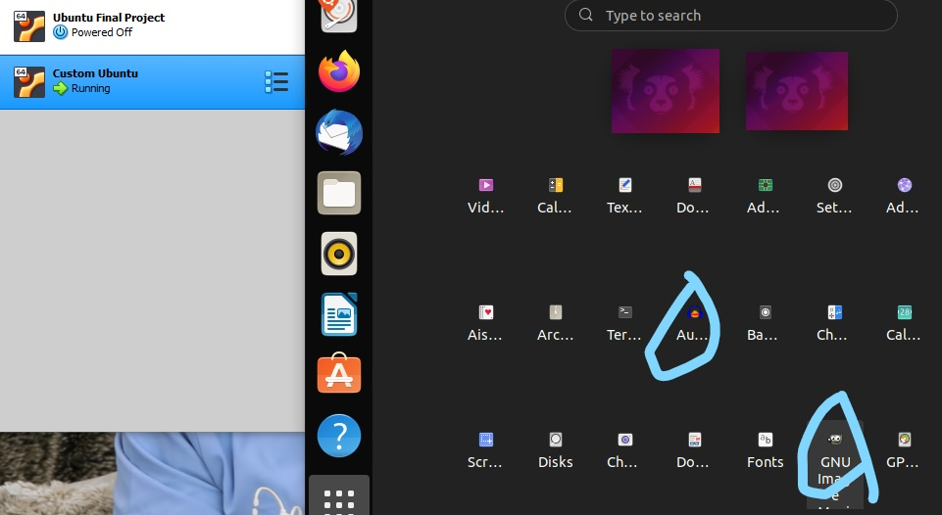
Major achievements
An ISO image for media professionals was successfully created. They don't have to install any editing software.

Slide 7
Overall Lesson
Improved our ability to use the terminal.
Use md5sum command to check if the copied iso image has been corrupted.

Slide 8
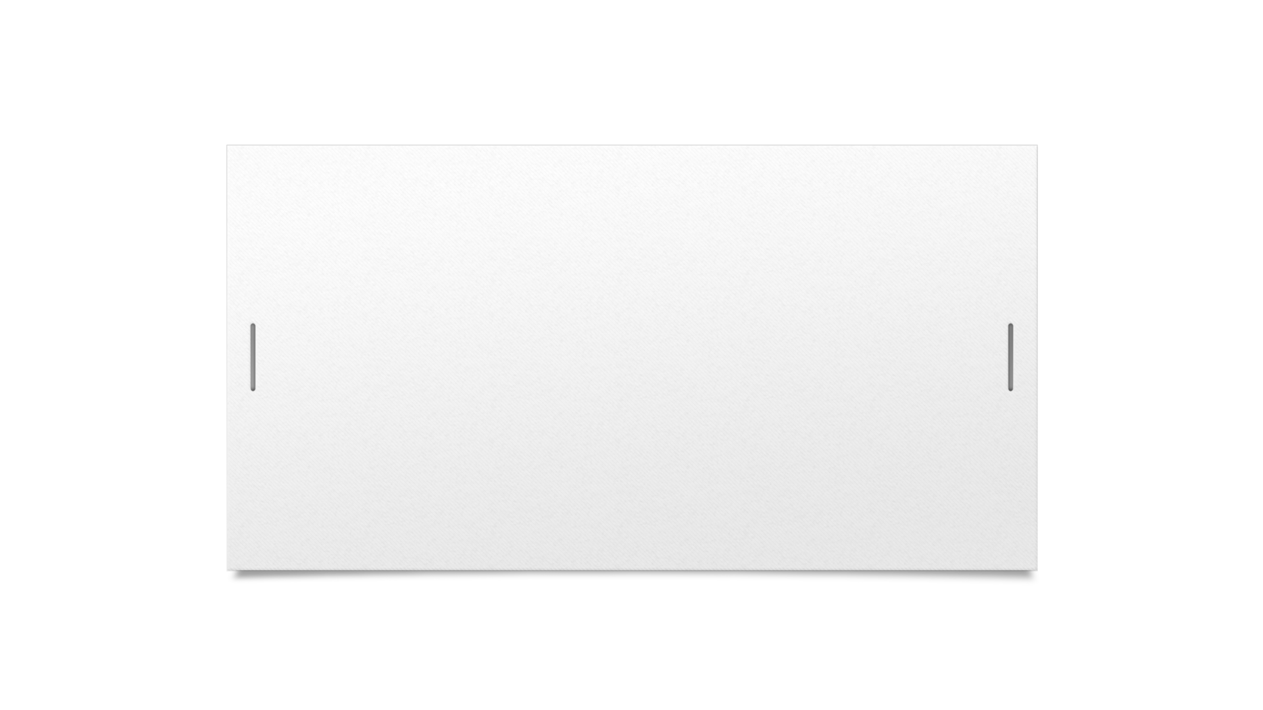
Thank you for listening!

